Slide 1

Welcome to Year 2

Slide 2
Year 2 team
Miss Jeremy: Year 2 class teacher Tuesday - Friday
e.jeremy@henhamugley.essex.sch.uk
Mrs Aves: Year 2 class teacher Monday
h.aves@henhamugley.essex.sch.uk
Mrs Bryant: TA mornings & Tuesday PPA cover
Mrs Stock & Miss Jenkins: TA afternoons

Slide 3
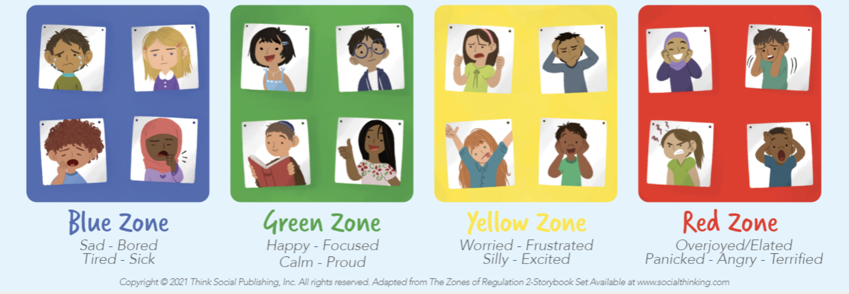
Routines
8.45am: Children to be in class – registration, choose their lunch for the day, zones board and ‘start of day’ morning maths work.
9.10am: Assembly
10.15am: BREAK
12-12.55pm: LUNCH
12.55 – 1.10pm: Quiet reading and read our class book.
3.15pm: HOME

Slide 4
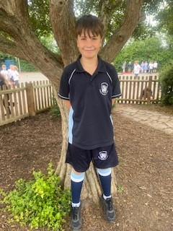
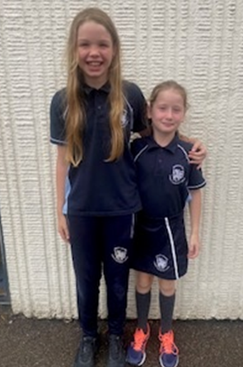
PE days are Tuesday & Friday
Autumn 1: Ball Skills
Autumn 2: Outdoor Adventurous Activities

Slide 5
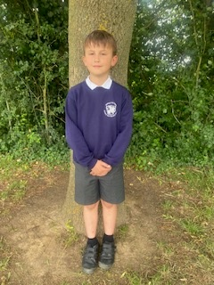
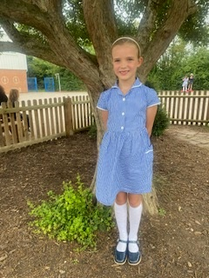
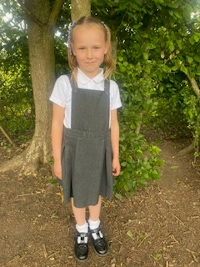
School uniform expectations

Slide 6

Homework will be issued every Friday to be handed in the following Wednesday
This will include:
Maths – times tables sheet and extra Times Table Rockstars practise
Reading – please read with your child as often as possible. We will also set a comprehension based on our current class book.
Spellings – look, cover, write, check sheet. Spelling test every Friday and Spelling Frame practise
On occasions we will set a ‘creative homework’ task – this will be topic linked.

Slide 7
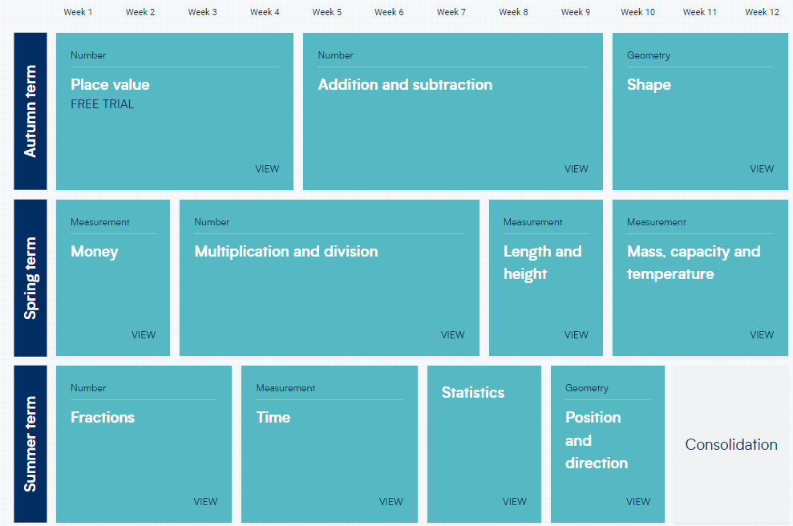
Maths: White Rose & NCETM
(National Centre for Excellence in the Teaching of Mathematics)
Mastery in Maths is an approach to teaching and learning that aims for children to develop a deep understanding of Maths rather than memorising key concepts or resorting to rote learning.

Slide 8












Writing
Autumn:
Harvest
Halloween
Black History Month
Memorial Day
Winter Wonderland
Writing units:
Descriptive writing of characters & settings
Recounts of real events
Letter writing
Poetry: written and performance
Non-chronological reports
Diary entries
Instructions
Myths
Adventure stories
Narrative writing
Spring
Mythical creatures
Whole school poetry project
Summer
-Travel
- Botanical World

Slide 9
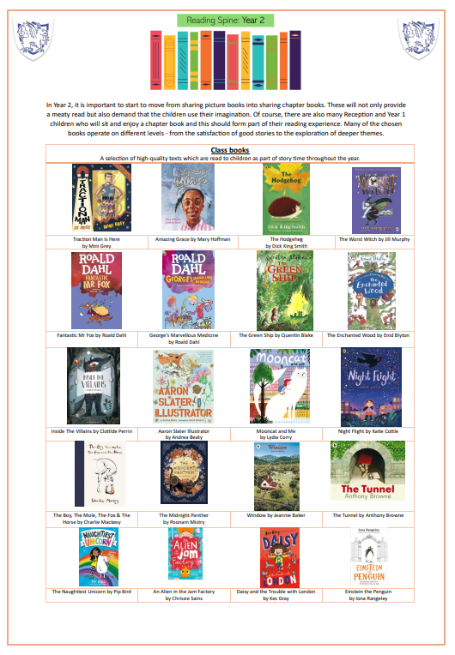
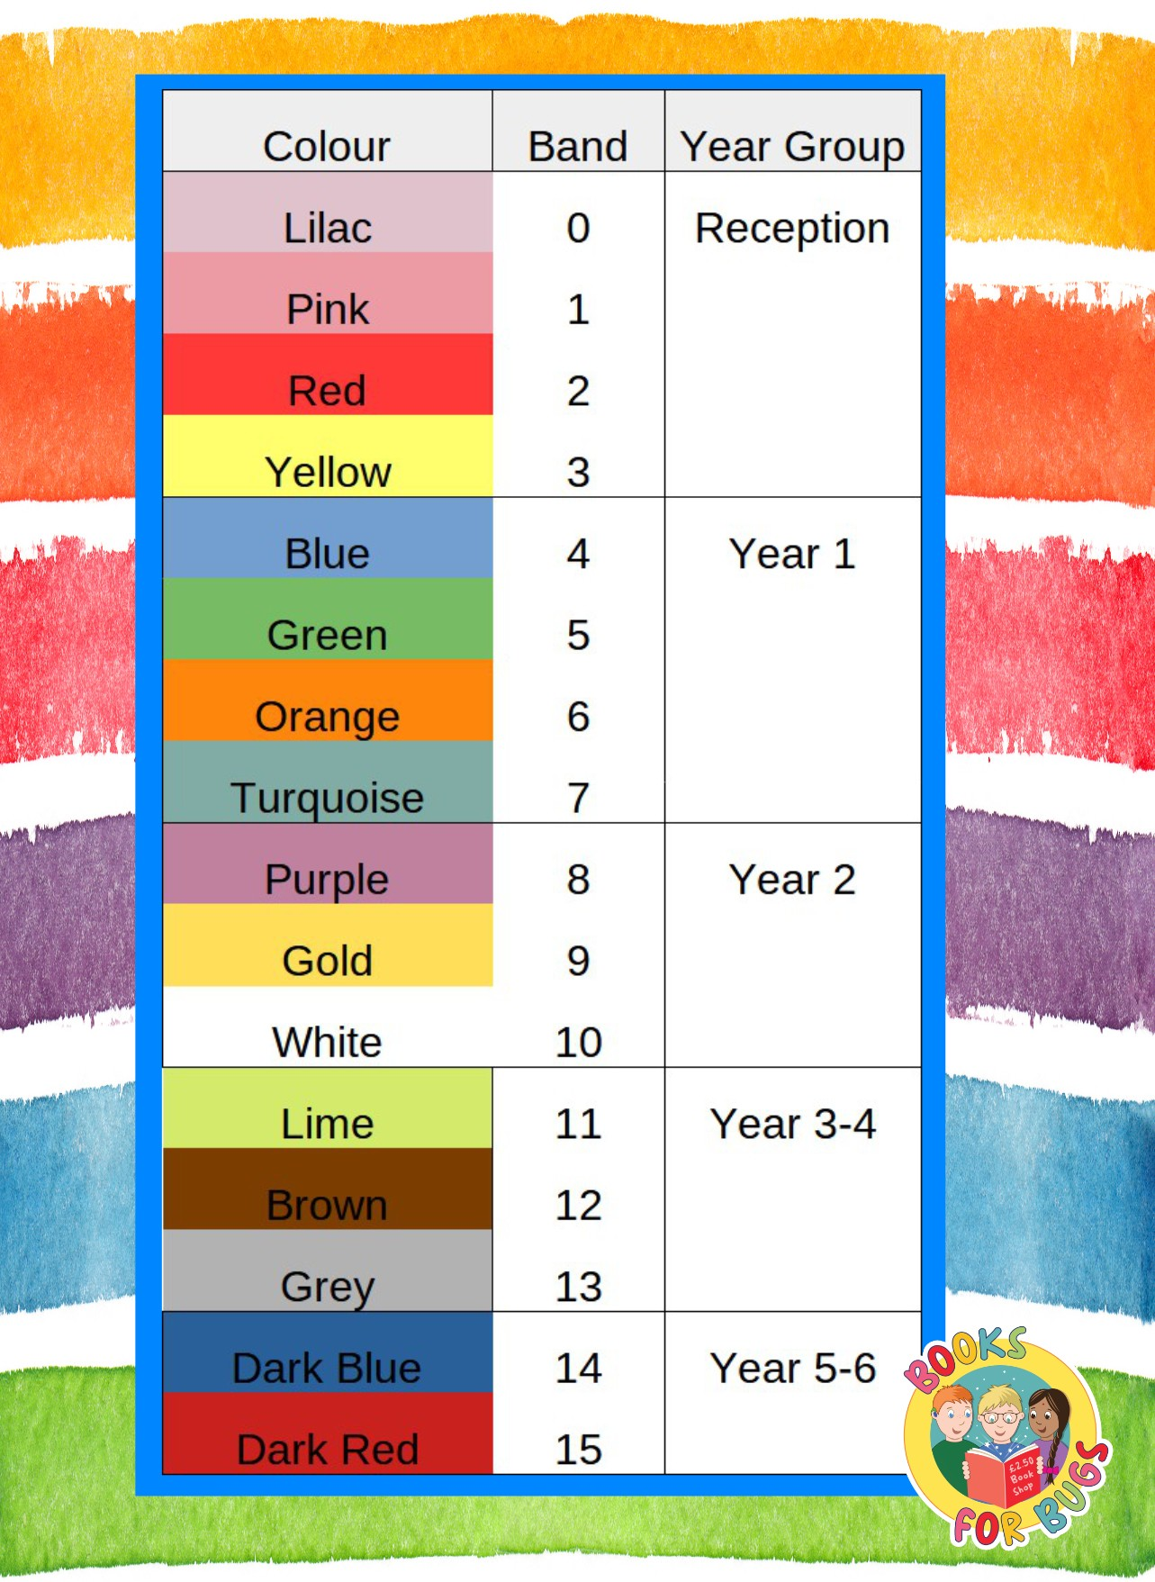
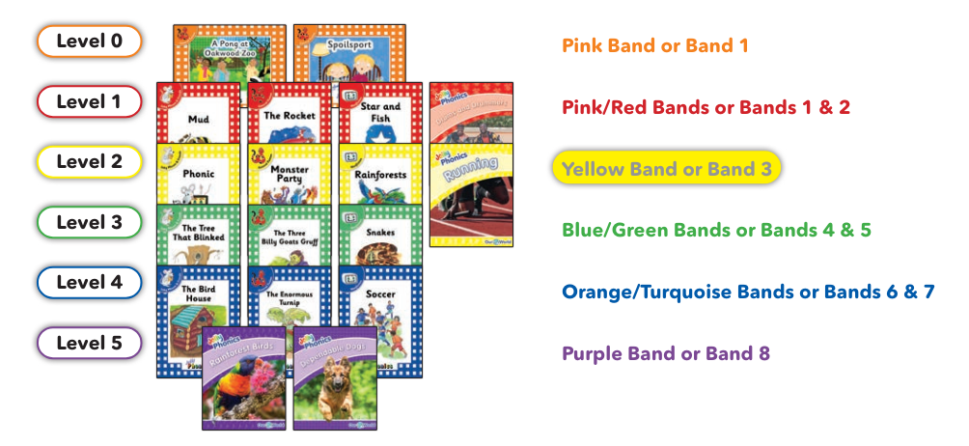
Reading

Slide 10






Reading: class books

Slide 11


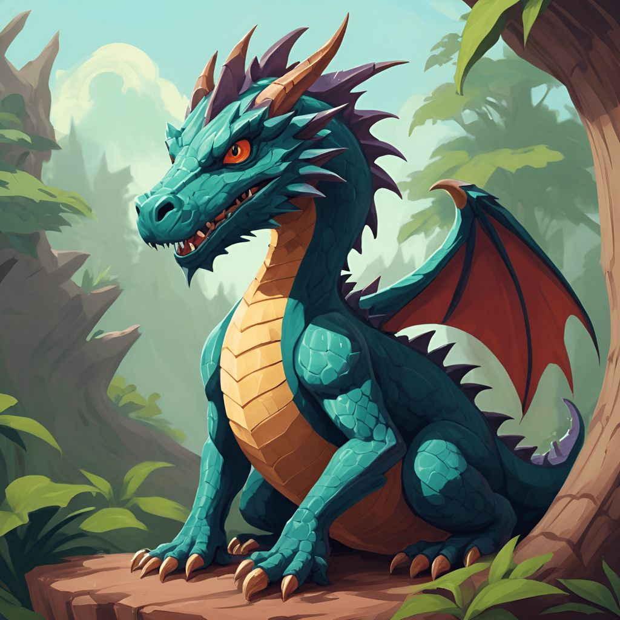
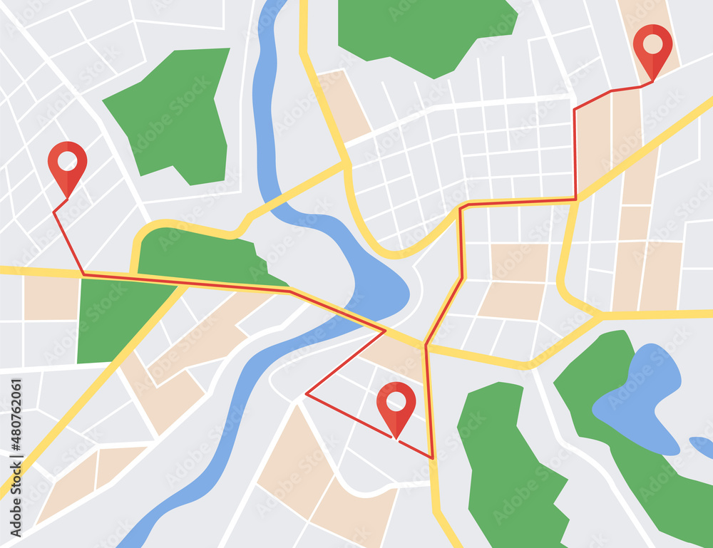
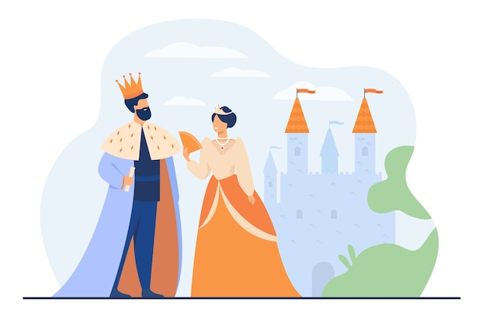

Topics
Autumn 1 | Autumn
Autumn 2 | Winter Wonderland
Spring 1 | Mythical Creatures
Spring 2 | Magical mapping
Summer 1 | Kings & Queens
Summer 2 | Plants

Slide 12
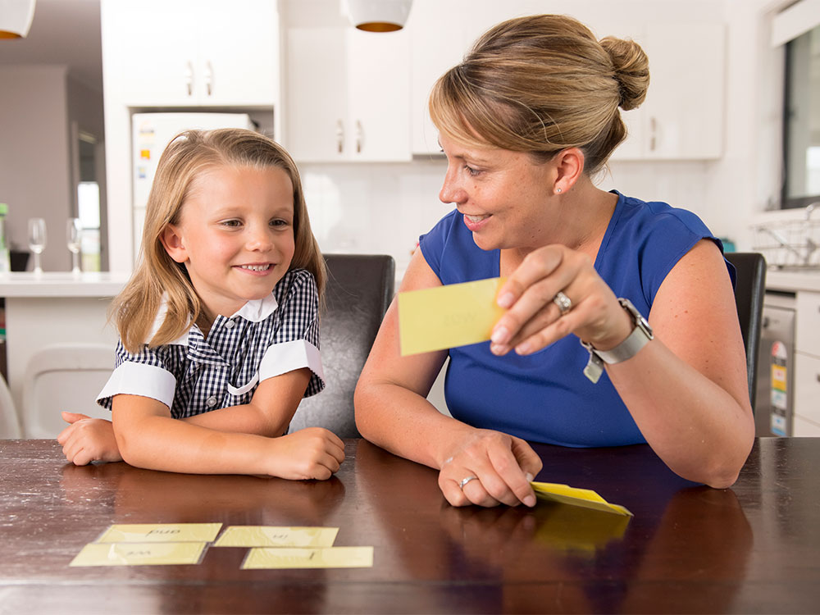

How can you help at home?
Reading – daily and diversify
Spelling & phonics – Spelling Frame & homework
Creative writing
Maths – times tables rock stars

