Slide 1


Welcome to Year 1
Michael Rosen Class

Slide 2
Our week
Currently…
Class Teachers
Mr. Dennison – Monday & Tuesday
Mrs. Townsend – Wednesday, Thursday & Friday
Eventually..
Mrs. Dixon – All week!
Teaching Assistants
Mrs Prout
Mrs Hampton
Mrs Caffery
Mrs Stock
Mrs Bryant

Slide 3
Routines
8.45am: Early morning work and registration
9.10am: Assembly.
Phonics & English
10.45am: BREAK
Maths
12-12.55pm: LUNCH
Foundation Subjects
2:00: BREAK
3.15pm: HOME

Slide 4
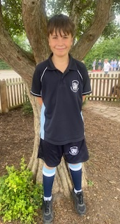
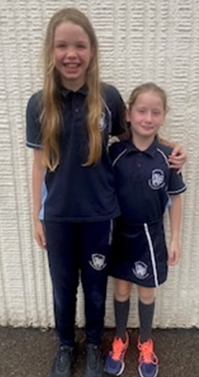
PE days are Tuesday and Wednesday

Slide 5
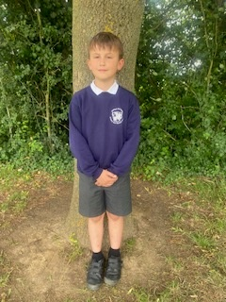
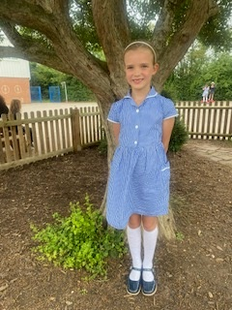
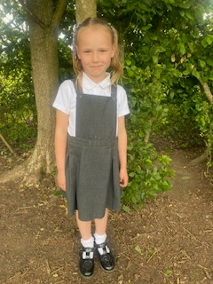
School Uniform Expectations

Slide 6
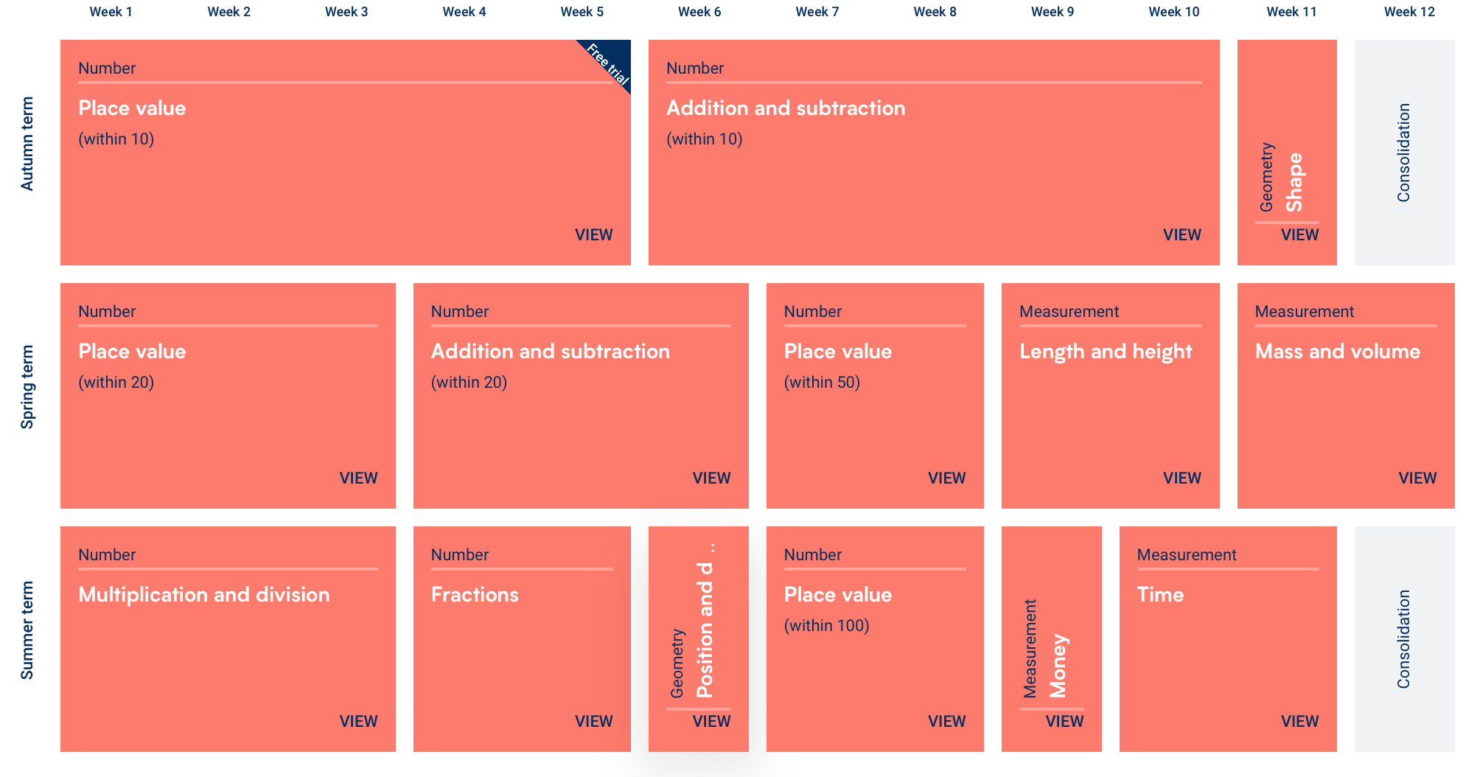
Maths in Year 1

Slide 7
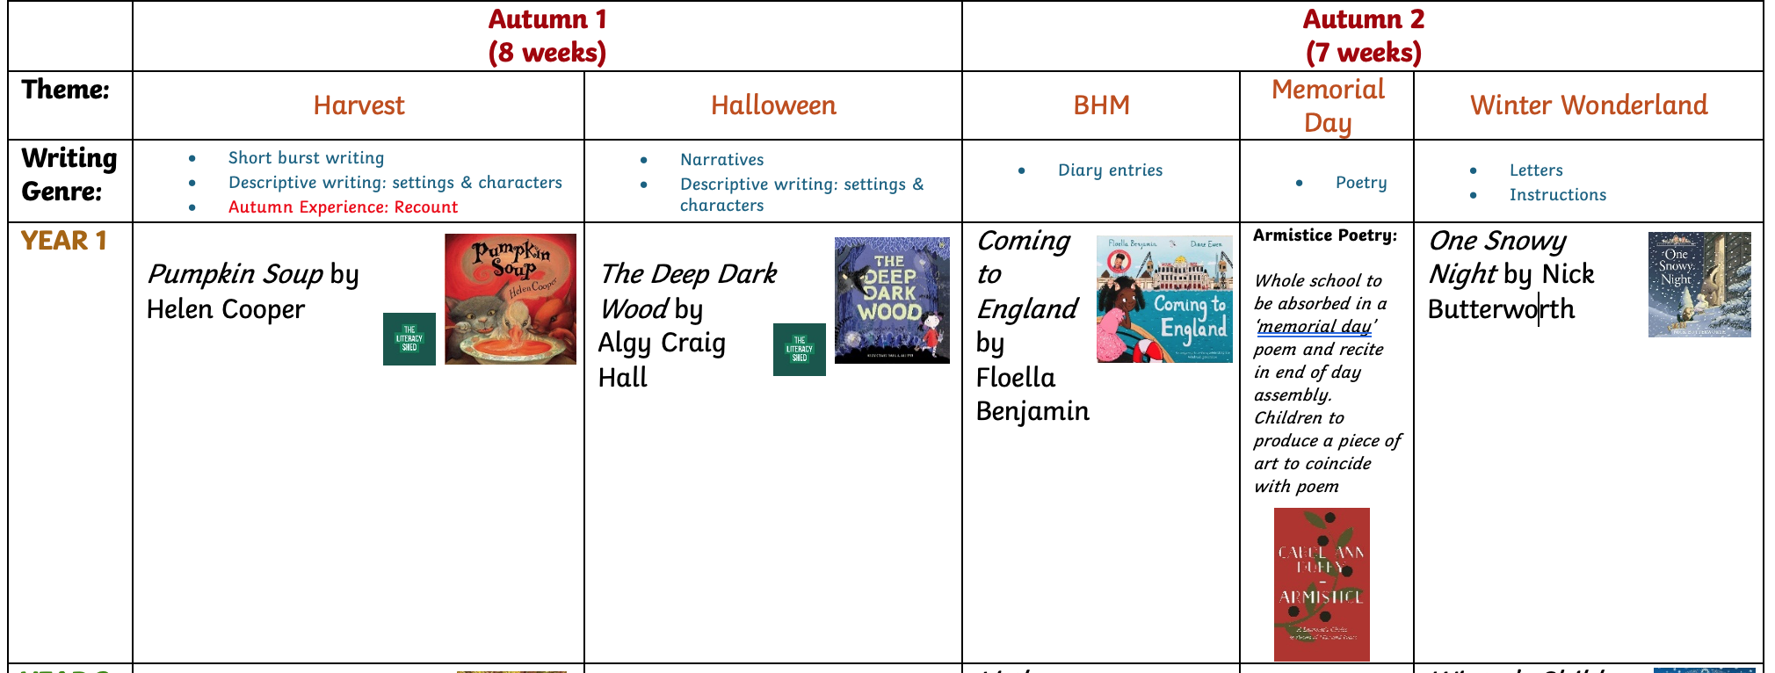
Writing in Year 1

Slide 8
Reading at home and phonics

Slide 9
Foundation topics
In Reception, your children will have explored foundation subjects through Expressive Arts and Design and Understanding the world. In Year 1, these subjects are split up into separate timetabled lessons.
More information on what we cover in each subject can be found on the long term plans
Science
History
Geography
Music
Computing
Art
D&T
PSHE
RSE
PE
RE

Slide 10
Classroom Rules and Behaviour Policy

Slide 11

Working together
You can email Mrs Dixon on
a.dixon@henhamugley.essex.sch.uk
Headteacher
Feel free to set up a meeting for a chat

