Slide 1


Welcome to Year 4 – Dick King Smith Class

Slide 2
Our week
Mr Harris – PPA Wednesday afternoon
PPA covered by Miss Gilbert

Slide 3



You can email me at:
k.harris@henhamugley.essex.sch.uk
You can arrange a meeting and pop in and see us.
Communicating with each other.

Slide 4

Routines
8.45am: Children to be in class – registration, choose their lunch for the day, zones board and ‘start of day’ morning work.
9.00am: Assembly.
10.15am: BREAK
12-12.55pm: LUNCH
3.15pm: HOME

Slide 5
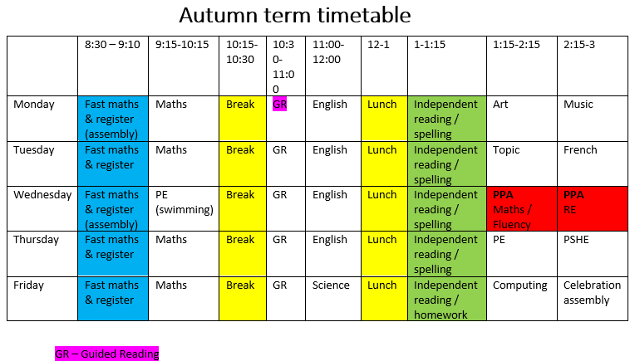

Slide 6
Leaving school arrangements
If you would like your child to go home with another person, please contact the office.

Slide 7
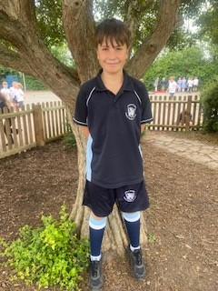

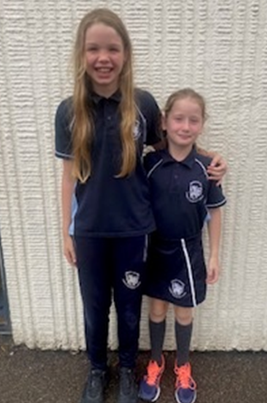
PE days are Wednesday and Thursday

Slide 8
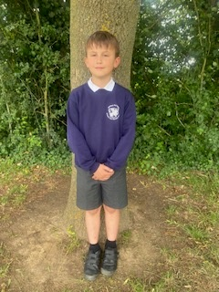
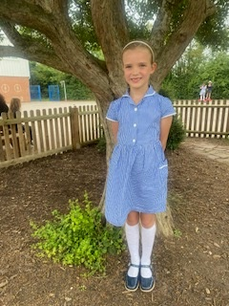
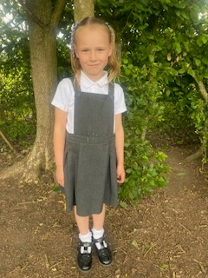
School uniform expectations

Slide 9

Homework will be issued on a Friday and previous weeks work is marked on a Friday
This will include:
Maths – a piece of worked linked to the class topic. Either through Purple mash or a worksheet plus TT Rockstar times table practise.
Reading – we expect your child to read every evening for a minimum of 15 minutes.
Grammar and punctuation – we will set a task for children to complete.
Spellings – these are set using Spelling frame.
On occasions we will set a ‘creative homework’ task – this will be topic linked.
Your child will be issued with a homework folder.

Slide 10
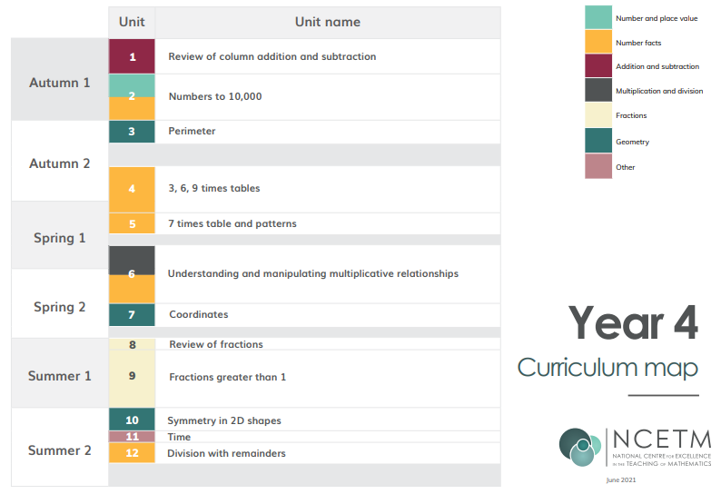

Slide 11
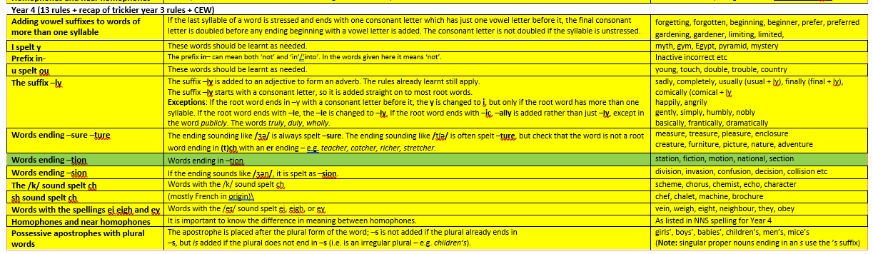
You will be issued with a copy of this. Spelling homework linked to the year 4 curriculum will be set on SPELLING FRAME weekly.

Slide 12


Writing in year 4
Writing Genres:
Narratives
Diary entry
Newspaper report
Balanced argument
Poetry
Instructions
Biographies
Speeches

Slide 13
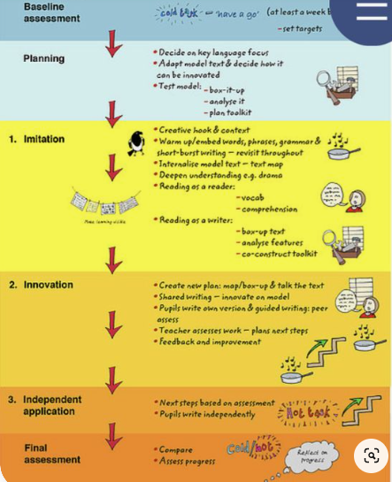


Slide 14


Our foundation topics for the year
Notes:
History, Art, Science, PE,

Slide 15
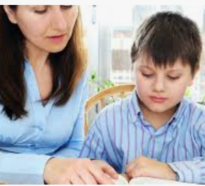
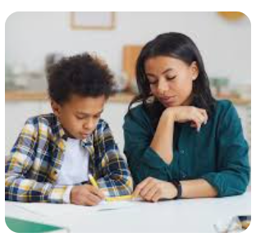
How can you help at home?

Slide 16
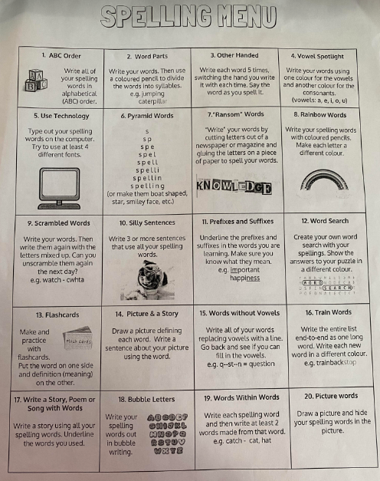
Spellings
Children will be set spellings each week, including words from a spelling rule and some year 3/4 common exception words.
Please engage with your children at home to help with spelling. Spellingframe is great for children to work independently. You could also help at home by testing your children on their weekly spellings as well as going over previously learned words.

Slide 17

Timestables
By the end of year 4 it is expected for children to be fluent in all their timetables. This requires practise both at home and in school!
See your packs for more details on how to best support your child at home.

Slide 18
Behaviour Policy
This can be found on our website.
Class rules and behaviour expectations.
When things go wrong.

Slide 19

Behaviour Policy

Slide 20

Be part of our school community!

Slide 21
Any questions?

