Slide 1


Welcome to
class

Slide 2
Our week
Mrs Brogan – Monday, Tuesday, Wednesday.
Mrs Laird – Thursday, Friday.
We meet on Thursdays to have our handover meeting.

Slide 3



You can email us:
n.brogan@henhamugley.essex.sch.uk
j.laird@henahmugley.essex.sch.uk.
You can arrange a meeting and pop in and see us.
Communicating with each other.

Slide 4

Routines
8.45am: Children to be in class – registration, choose their lunch for the day, zones board and ‘start of day’ morning work.
9am: Assembly.
10.15am: BREAK
12-12.55pm: LUNCH
3.15pm: HOME

Slide 5
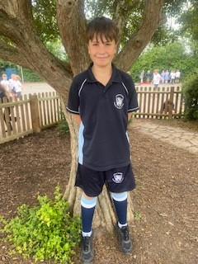

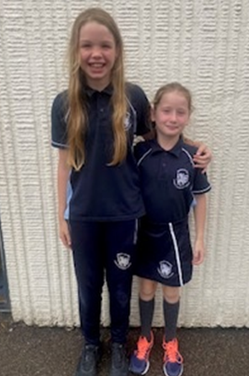
PE days are Wednesday and Friday

Slide 6
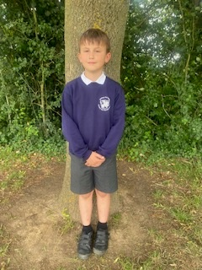
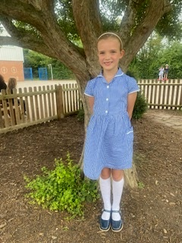
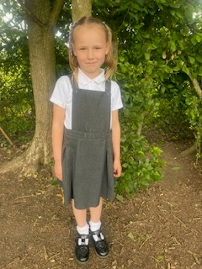
School uniform expectations

Slide 7

Homework will be issued on a Friday and work is marked on the next Wednesday.
This will include:
Maths – a piece of worked linked to the class topic. Either through Purple mash or a worksheet plus TT Rockstar times table practise.
Reading – we expect your child to read every evening for a minimum of 15 minutes. We will also set a comprehension.
Writing – we will set a short writing activity – this will not be every week.
Spellings – these are set using Spelling frame.
On occasions we will set a ‘creative homework’ task – this will be topic linked.
Your child will be issued with a homework folder.

Slide 8
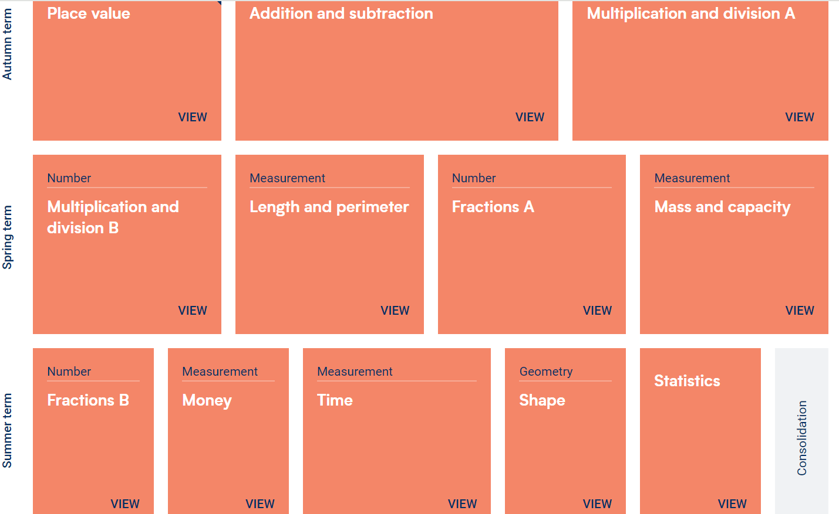

Slide 9
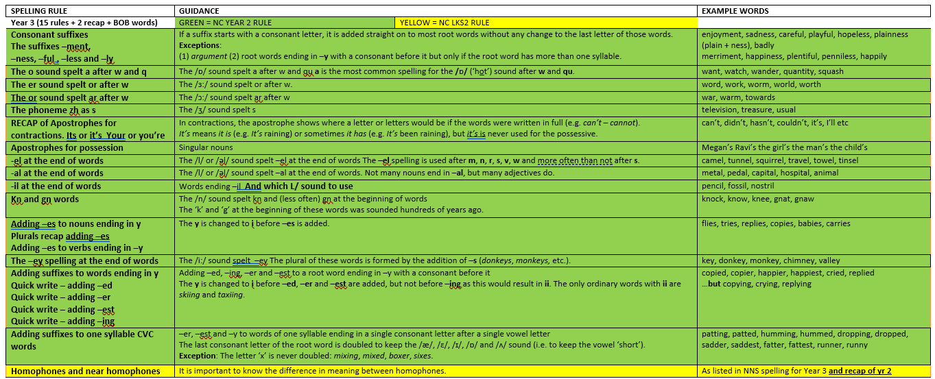
You will be issued with a copy of this. Spelling homework linked to the year 3 curriculum will be set on SPELLING FRAME weekly.

Slide 10

Writing in year 3

Slide 11

Our foundation topics for the year
Autumn | Stone Age | Winter Wonderland
Spring | Mythical Creatures | Poetry
Summer | Travel | Botanical World & Ancient Egypt

Slide 12
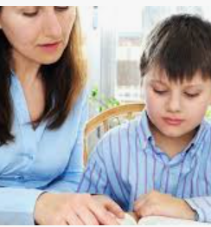
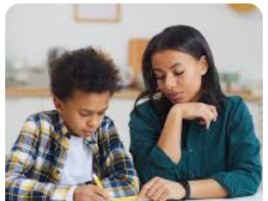
How can you help at home?

Slide 13
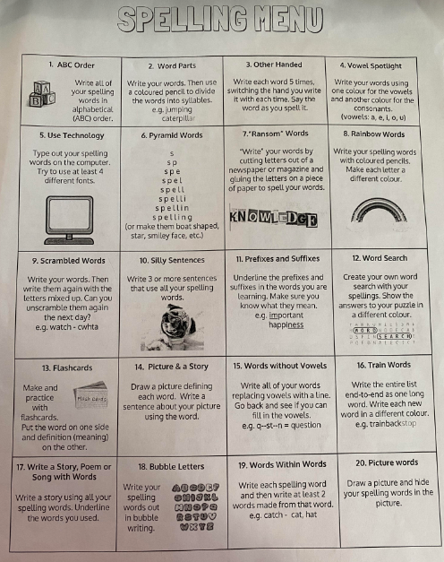
Spellings
Some children are able to memorise words and find spelling much easier than others. If your child finds it hard here are some tips.
Never try to learn them all at once. Its far better to learn 2 words a week and for them to be ingrained in their long-term memory, than learn 8 and forget them all the next day.
Be as creative and multi-sensory with learning as possible.
Use our spelling menu to try out different ideas and empower your child to use the methods they find most helpful.

Slide 14


Slide 15
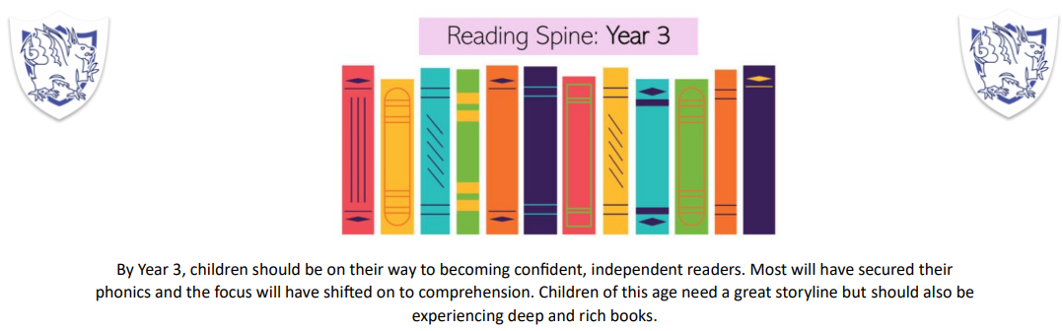
Our accelerated reader scheme

Slide 16
Behaviour Policy
This can be found on our website.
Class rules and behaviour expectations.
When things go wrong.

Slide 17

Be part of our school community!

