Slide 1

Welcome to
Year 5
JK Rowling Class

Slide 2

Routines
8.45am: Children to be in class – registration, choose their lunch for the day, zones board and ‘start of day’ morning work.
9.00am: Assembly.
10.45am: BREAK
12-12.55pm: LUNCH
3.15pm: HOME

Slide 3
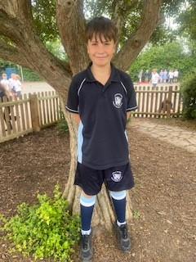

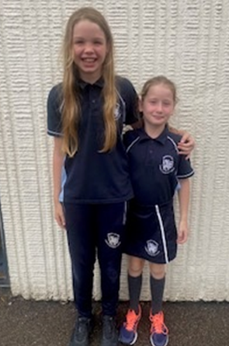
PE days are Tuesday and Wednesday

Slide 4

Homework will be issued on a Friday and should be returned by the following Thursday. This allows us to mark the homework ready for the next piece of homework to be set.
This will include:
Maths – a piece of worked linked to the class topic. Either through Purple mash or a worksheet plus TT Rockstar times table practise.
Reading – we expect your child to read every evening for a minimum of 15 minutes. We will also set a comprehension.
Grammar- a piece of worked linked to the class topic. Either through Purple mash or a worksheet
Spellings – these are set using Spelling frame.
On occasions we will set a ‘creative homework’ task – this will be topic linked.
Your child will be issued with a homework folder.

Slide 5
Leaving school independently
In year 5 we are happy for your child to leave school independently. If you would like your child to meet you outside school premises/walk home, you will need to give written (email) permission.

Slide 6
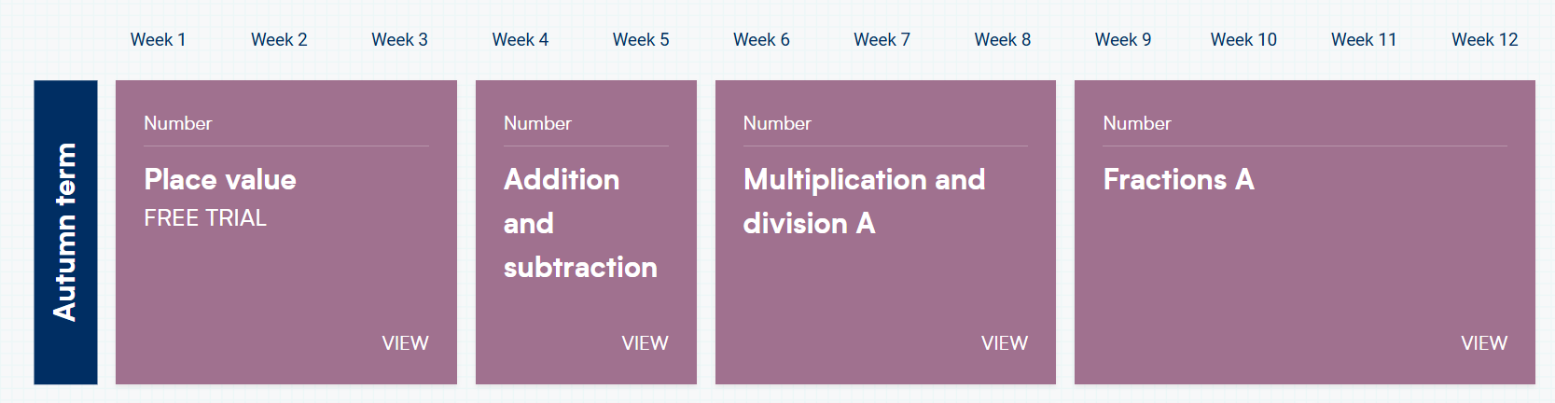
Maths – Autumn term

Slide 7
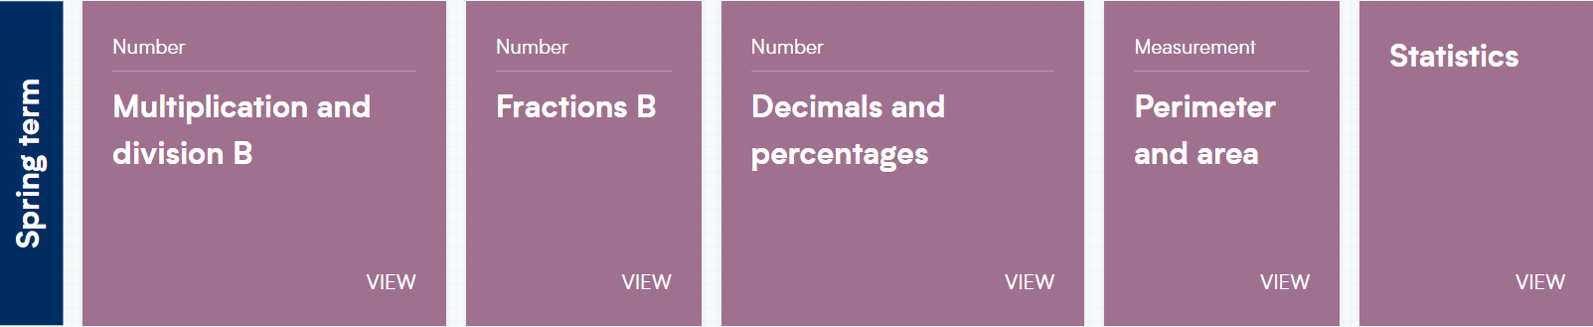
Maths – Spring term

Slide 8
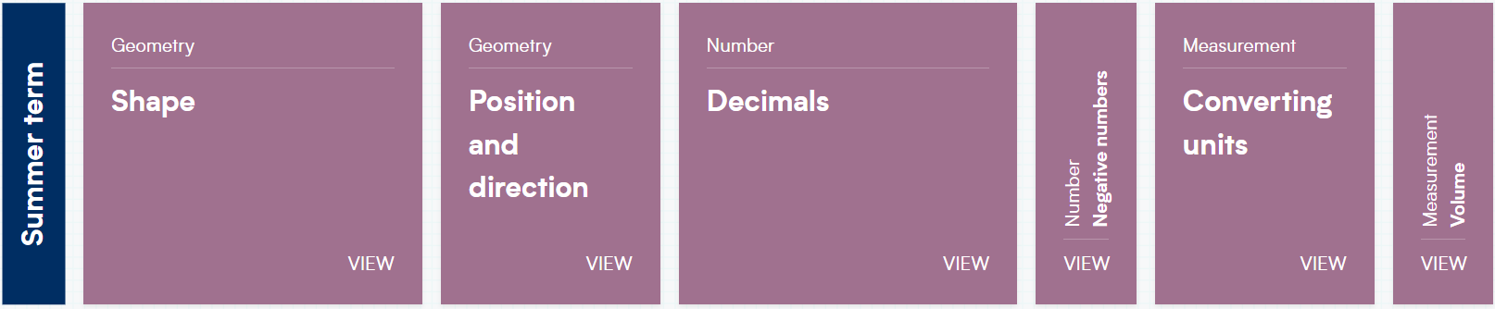
Maths – Summer term

Slide 9
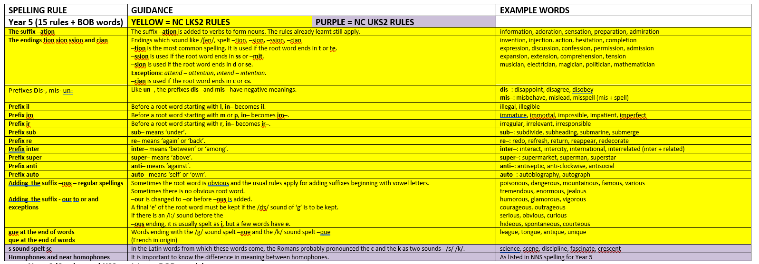
You will be issued with a copy of the spellings for this year. Also, the reading spine list for Year 5

Slide 10

Text types in year 5
Descriptive writing
Diary entries
Poetry
Letter writing
Instructional writing
Newspaper report
Designing and publishing a poster
Designing and publishing a leaflet
Recount
Persuasive writing
Non-chronological report

Slide 11
Reading
It is easy (and totally understandable) to feel like you no longer need to engage with your child’s reading once they are in year 5, especially if they have progressed to free reader. However, spending a little time listening to them read can make a huge impact on their learning and progression. It helps with vocabulary, understanding, their writing, spelling just to name a few.
It is important to both listen to your child read and talk to them about it.

Slide 12

History Topics
Ancient Mayans
Anglo Saxons and Vikings
The history of Henham

Slide 13
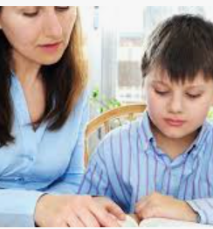
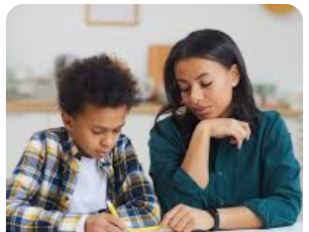
How can you help at home?

Slide 14
Behaviour Policy
This can be found on our website.
Class rules and behaviour expectations.

Slide 15
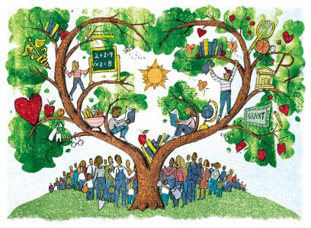
Thank you!
Your turn.
Questions for me

