Slide 1


Welcome to Year 6 Morpurgo Class

Slide 2
Our week
PE is on Monday and Thursday
This Autumn we will be focussing on Team building activities and on Football.
Mrs Miley will cover Wed morning.

Slide 3
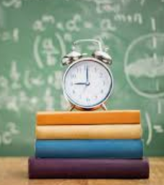
Routines
8.45am: Children to be in class – registration, choose their lunch for the day, zones board and ‘start of day’ morning work.
9.10am: Assembly.
10.45am: BREAK
12-12.55pm: LUNCH
3.15pm: HOME
Please ensure that we have written permission allowing your child to walk home from school.

Slide 4
Weekly
Timetable
Year 6
 | 8:30-9:00 | 9:00-9:15 | 9:15-10:15 | 10:15-10:45 | 10:45-11:00 | 11:00-12:00 | 12:00-1:00 | 1:00-1:15 | 1:15-2:15 | 2:15-3:15
Monday | Registration | School Value Assembly | Maths | Guided Reading | Playtime | Writing | Lunch | DEAR Reading | PE | ART
Tuesday | Registration | Class Value Assembly | Maths | Guided Reading | Playtime | Writing | Lunch | DEAR Reading | PSHE | RE
Wednesday | Registration | Singing assembly | French Guided Reading | History/ Geog | Playtime | French/RS | Lunch | DEAR Reading | Computing | History
Thursday | Registration | Newsround | Maths | Guided Reading | Playtime | Writing | Lunch | DEAR Reading | Music | PE
Friday | Registration | DEAR Reading Team pts | Maths | Guided Reading | Playtime | Writing | Lunch | Homework | Science | Assembly 3:00-3:15

Slide 5



You can email us:
l.fleming@henhamugley.essex.sch.uk
s.miley@henhamugley.essex.sch.uk
Please feel free to pop in or to arrange a meeting to see us.

Slide 6
Leaving school independently
In year 6, we are happy for your child to leave school independently. If you would like your child to meet you outside school premises/walk home, you will need to give written (email) permission.

Slide 8
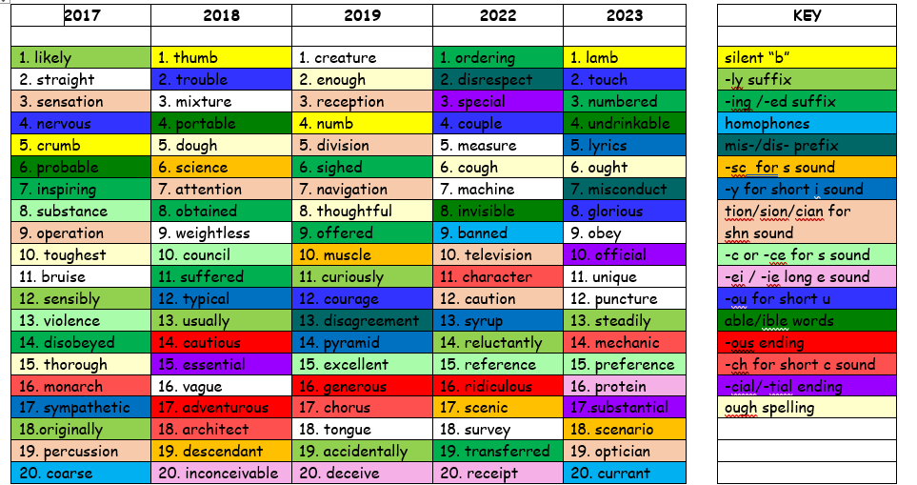

Slide 9
 | Week 2 5.9.24 | Week 3 12.9.23 | Week 4 19.9.23 | Week 5 26.9.23 | Week 6 3.10.23 | Week 7 10.10.23 | Week 8 17.10.23
School Rules | We listen to each other. | We make good choices. | We are polite, helpful, and respectful. | We are gentle with kind hands, actions, and words. | We value and encourage each other. | We look after everyone and everything. | We try our best with our learning.
Maths | Place Value Numbers to ten million, powers of 10.... | Place Value Compare, order and round integers Negative numbers | Four Operations Integers, factors, multiples and rules of divisibility. | Four Operations Division and remainders. | Four Operations Primes, squares, cubes, multiplication | Four Operations Multi-step problems and estimation. | Fractions Equivalence, simplifying, comparing and
Special Days | Baseline | Democracy week | Elections Eco Pupil Voice House captains |  | National Poetry Day 6/10 INKTOBER | Mental Health Day 10/10 | Mapping Skills Day
 | Letter to applying to be a play leader Great Paper Caper/Francis Writing Moderation | Narrative: Short Story 1. Rose Blanche Diary Immersion 2.story board and sequence 3.write | . Non-Chronological report 1. 2. Focus on conjunctions. 3. Focus on colons, captions and glossary 4. Conclusion | 4.write Non-Chronological report 1. Features 2. Examples and research ICT 3. Introduction 4. | Newspaper: Windrush. 1.Immersion/inter views 2. Quotes 3. National Poetry Day 4. Writing day | 1 Newspaper: Windrush. 1. Writing day 2 2. Captions and presentation Narrative: Short Story: 3. Literacy shed video (ruin) 4. Character and setting description | Narrative: Short Story: 1. Dialogue to move plot on 2. Beginning and build up 3. Problem and resolution 4. Share stories and peer review feedback
Class Reader |  |  | Streetchild |  |  |  | The Piano/Ruin

Slide 10

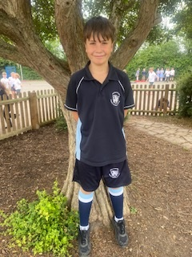
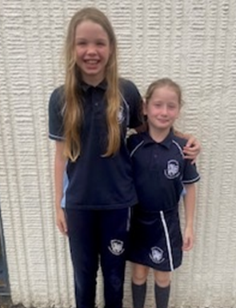

Slide 11
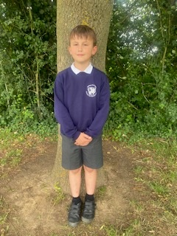
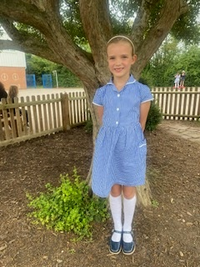
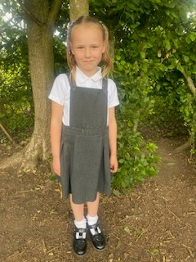
School uniform expectations

Slide 12

Homework will be issued on a Friday and previous weeks work is marked on a Friday.
This will include:
Spellings – these are set using Spelling frame.
Reading every evening (10 minutes)
A daily homework sheet
TT Rockstars
Your child will be issued with a homework folder.

Slide 13
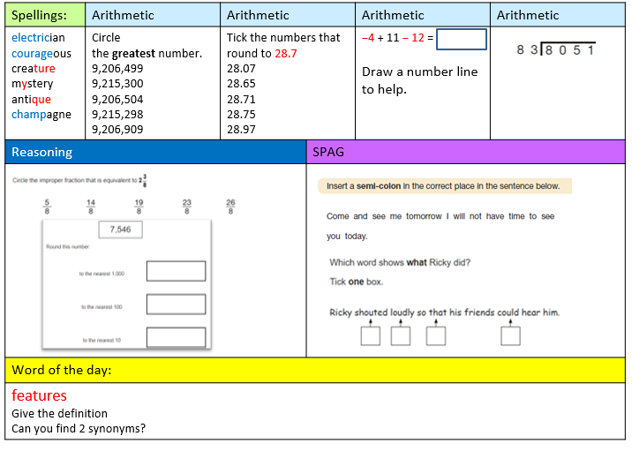
Mon - Thursday

Slide 14
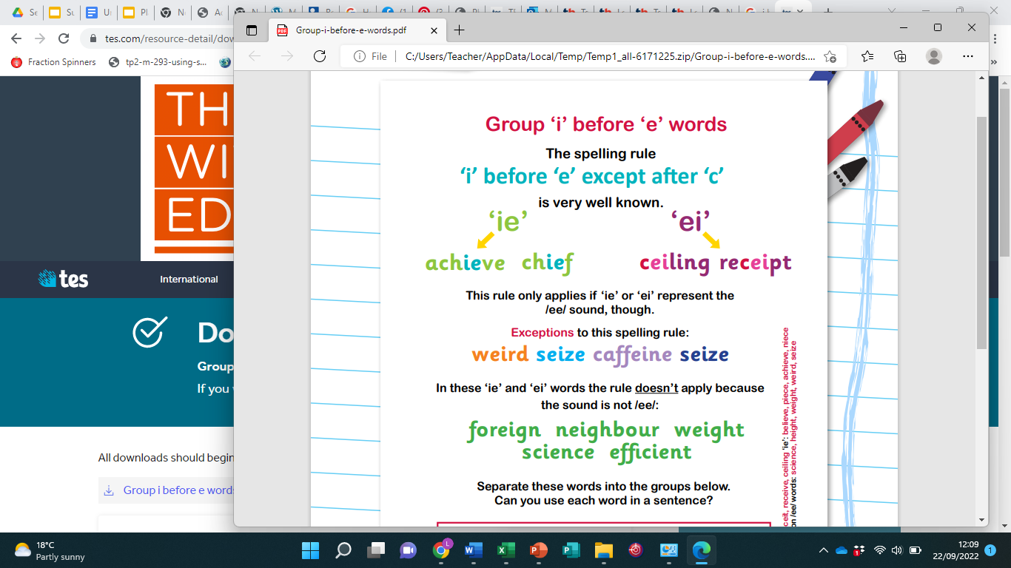
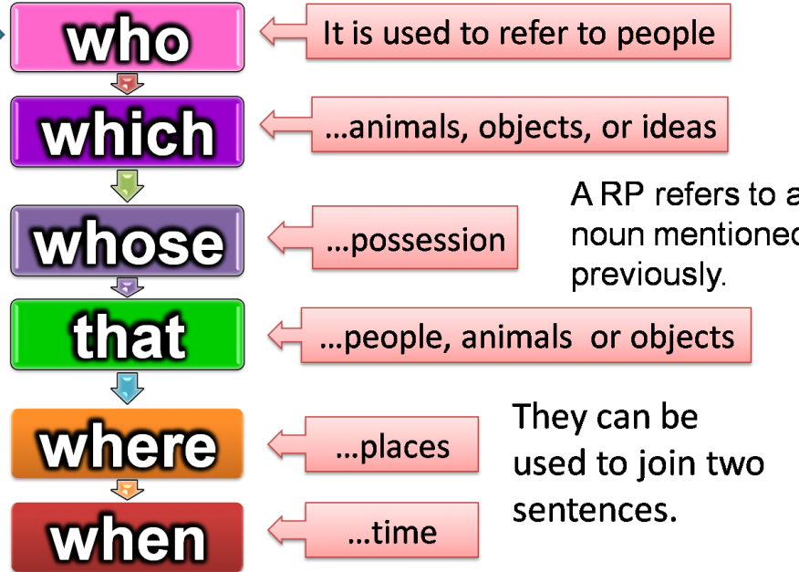
Week 2: Friday
Spellings: | Reading | Other |  | Reading | TT Rock Stars
Please complete spelling frame. Our rule for this week is i before e except after c | Please complete this week’s comprehension | Please remember to bring in any 500ml plastic coke bottles with their lids for our science experiment. |  | Please read for 10 minutes each evening | Please continue to memorise your square numbers to 100 and your prime numbers to 20
Things to remember: |  |  | SPAG
 |  |  | Can you name 5 relative pronouns? Remember a relative pronoun introduces a relative clause. It tells us extra information that relates to the noun.

Slide 15
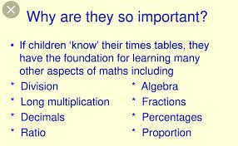

Slide 16
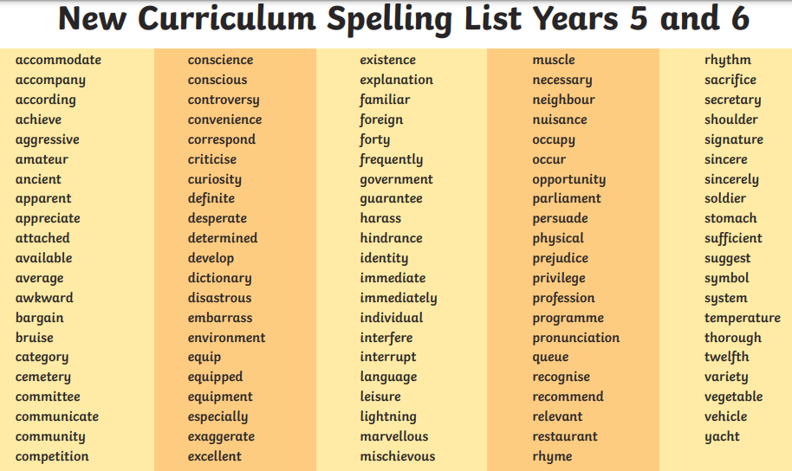

Slide 17
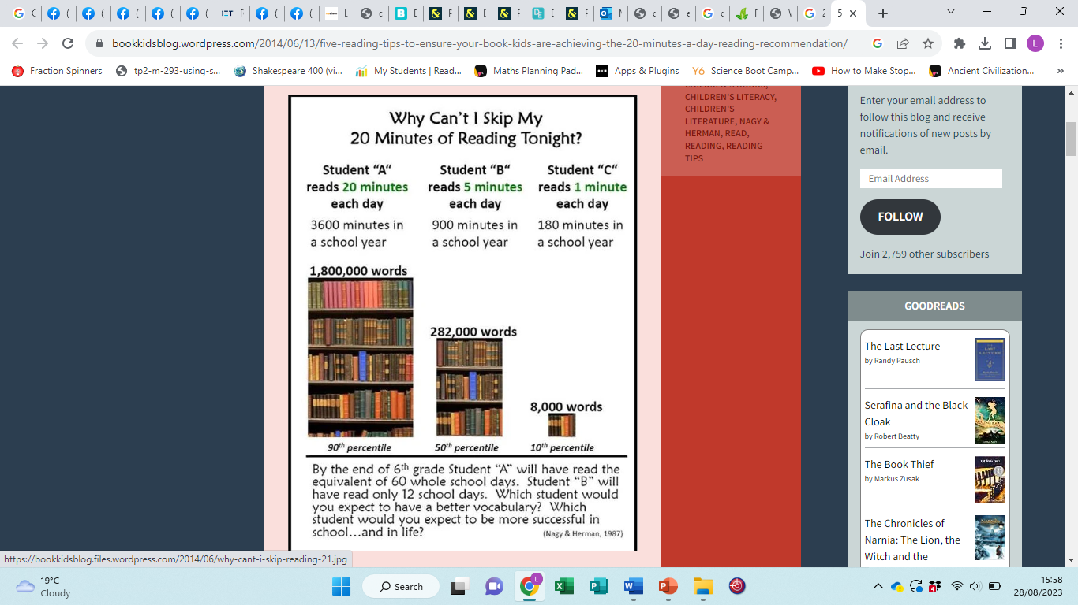
Reading

Slide 18




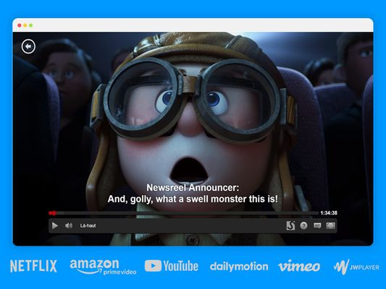



Reading

Slide 19
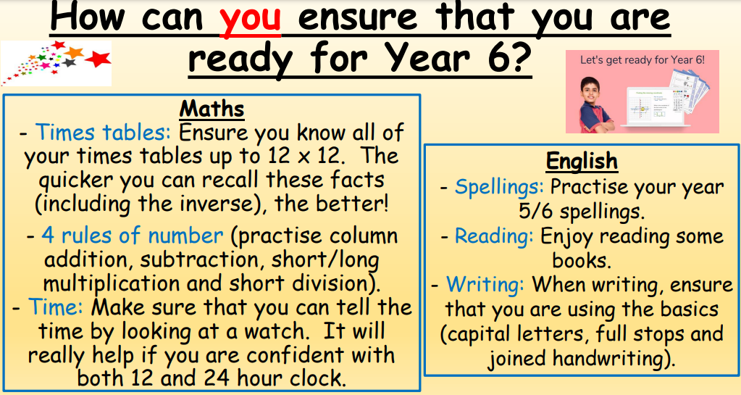

Slide 20
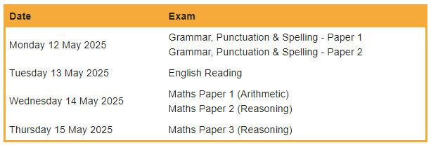
Sats
Sats 2025

Slide 21




Roles of Responsibility

Slide 22





Slide 23
Behaviour Policy
This can be found on our website.
Class rules and behaviour expectations.
When things go wrong.

